Slide 1
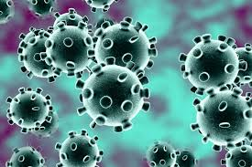
Applying Behavioural Science to Combating Pandemics
Susan Michie
Professor of Health Psychology,
University College London, UK
@SusanMichie
University of Oxford, 2022

Slide 2
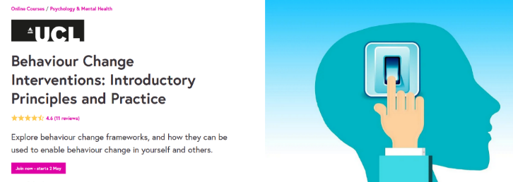
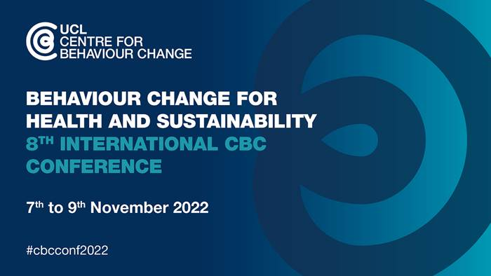
www.ucl.ac.uk/behaviour-change/
@UCLBehaveChange
Activities include
International Schools; online short course
Annual Conference
MSc in Behaviour Change
Hubs for exchanging skills, ideas, resources
Environment & Behaviour
Digi-hub
Who are we?
Researchers, consultants, trainers & practitioners in behaviour change
A cross-disciplinary community of academic experts at UCL & beyond
Global network of > 4,000 contacts

Slide 3
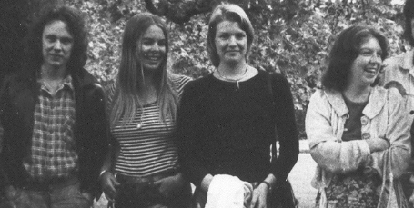
My career pathway – not straight! Academic & applied
Education:
Experimental psych, Oxford; Clinical psych, IoP; DPhil, Developmental psych, Oxford
Work:
NHS clinical psychologist, gradually getting more involved in research
Health/occupational/organisational psychology, Royal Free Hospital
Wellcome-funded programme research fellow, psych aspects of genetic testing
Head-hunted for new post in Health Psychology, UCL, began research programme into behaviour change
Other activities:
Chair BPS Div Health Psych; President of European Health Psych Society; Consultant to Dept Health; NICE Cttees; National Exec MSF 1980s-90s; SAGE 2009 & 2020

Slide 4
COVID-19 Scientific Advisor roles
UK Government’s advisory group SAGE
Behavioural science sub-group
Independent SAGE
set up by previous Chief Scientific Advisor to complement scientific work of SAGE
Served as COVID-19 consultant advisor to WHO Behavioural Insights team
Lancet COVID-19 Commission Public Health Taskforce

Slide 5
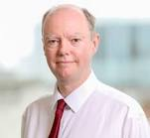
SAGE (SPI-B) provides advice to Cabinet Office
SAGE is large & complex; many groups & people feeding into it
Huge scientific talent
Responsive mode – work to commissions from Government
Delays - sometimes weeks between work completion & publication
Translational pathway not transparent
Prof Chris Whitty, Chief Medical Officer

Slide 6
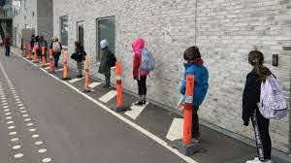
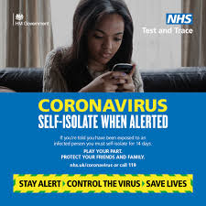
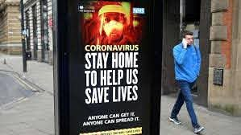
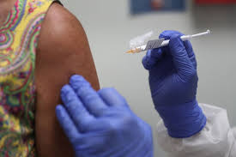
Citizens’ behaviour and pandemics: key areas
Personal protective behaviours
Distancing, outdoors/ventilation, face coverings, hand/surface hygiene
Adherence to public health measures & rules, e.g.
Test, Trace, Isolate Systems
Having a test, giving contacts, isolating
Restrictions inc. border controls, lockdowns
Vaccination uptake

Slide 7
Main messages
There is a science of behaviour and ignoring it matters,
e.g.
Test, Trace & Isolate
‘Behavioural fatigue’
Current policies
2. UK’s science-policy advisory mechanisms should be re-evaluated

Slide 8
UK behavioural science: positive impact?
Informal views as no monitoring mechanism ….
Measures we judged to be harmful were limited or delayed
e.g. limited scope of vaccine passports; delayed monetary fines for self-isolation
More liberal social bubbles
Designed and rolled out community champion programme
contributed to higher vaccine uptake among minoritised groups
Achieved some evaluations of behavioural interventions

Slide 9
But many examples of advice ignored or misused
Test, Trace and Isolate
advice not implemented
‘Behavioural fatigue’
behavioural science misused/blamed

Slide 10
Test, Trace & Isolate
UK estimate of % symptomatic people required to isolate to effectively reduce transmission: 80%
What happened?
Corsair Study:
UK nationally representative population survey
2000/week since March 2020
http://epr.hpru.nihr.ac.uk/our-research/research-themes/response/corsair-study
https://osf.io/gfs9x/; 15 papers

Slide 11
Problems: getting tested, giving contacts, self-isolating
https://www.bmj.com/content/bmj/372/bmj.n608.full.pdf
53 880 symptomatic people, March 2020- Jan 2021:
% isolating: <50%
% requesting test: <30%

Slide 12
Why? How to tackle the low level of self-isolation?
Often the assumption is that the problem is one of motivation -
Is this the case?
Need a model of behaviour

Slide 13
The COM-B model: Behaviour occurs as an interaction between three necessary conditions
Psychological or physical ability to enact the behaviour
Reflective and automatic mechanisms that activate or inhibit behaviour
Physical and social environment that enables the behaviour
Michie et al (2011) Implementation Science; https://www.qeios.com/read/WW04E6.2

Slide 14
Effective policy requires understanding the problem
Without a correct ‘behavioural diagnosis’, an intervention or policy is unlikely to be effective

Slide 15
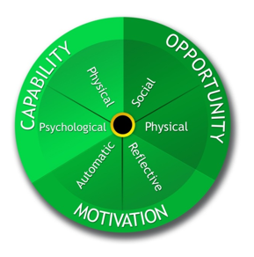
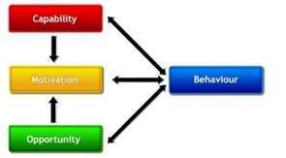
Behaviour Change Wheel: a framework for designing interventions
Applied work can be helpful to Universities!
4* 2022 REF Impact Case

Slide 16
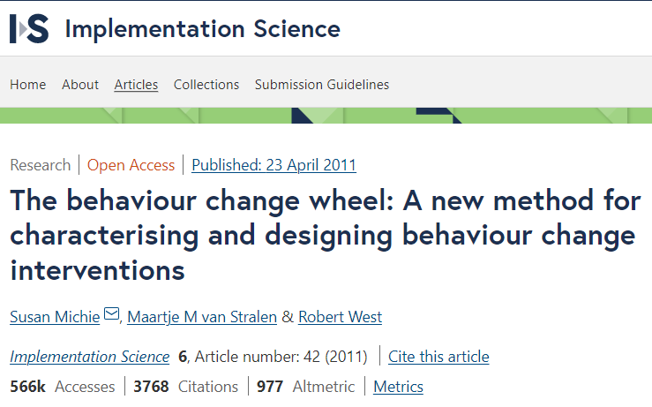
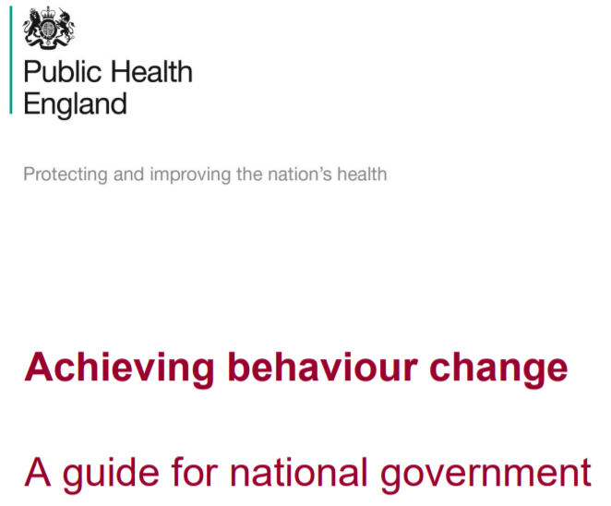
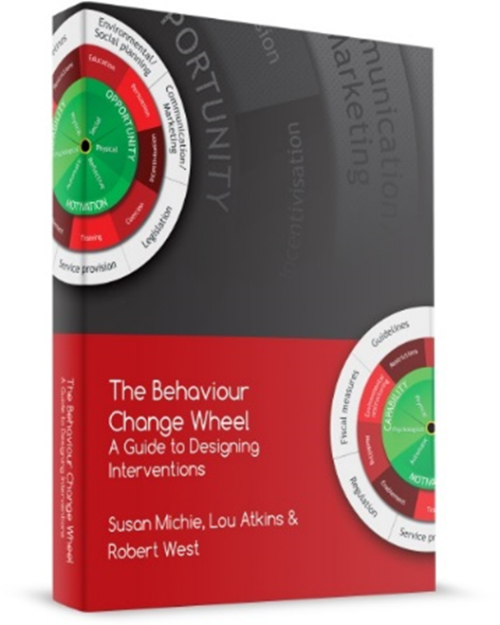
COM-B and the Behaviour Change Wheel
Brief guide available on Centre for Behaviour Change website
www.ucl.ac.uk/behaviour-change
https://assets.publishing.service.gov.uk/government/uploads/system/uploads/attachment_data/file/933328/UFG_National_Guide_v04.00__1___1_.pdf

Slide 17
Back to the problem: minority self-isolating
https://www.bmj.com/content/bmj/372/bmj.n608.full.pdf
53 880 symptomatic people, March 2020- Jan 2021:
% isolating: <50%
% requesting test: <30%

Slide 18
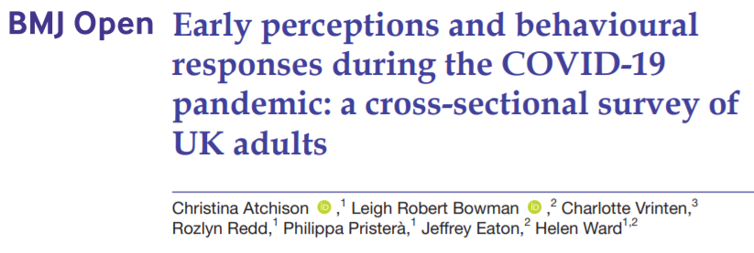
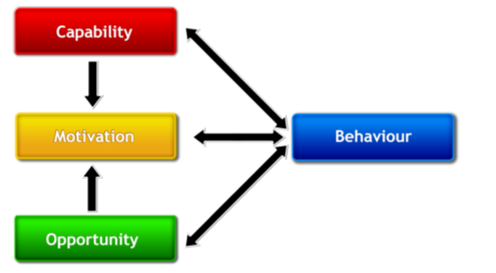
Motivation or opportunity?: socio-economic differences
87% willing to self-isolate
across all income levels
Those with the lowest household income
3x less likely to be able to self-isolate
6x less likely to be able to work from home

Slide 19
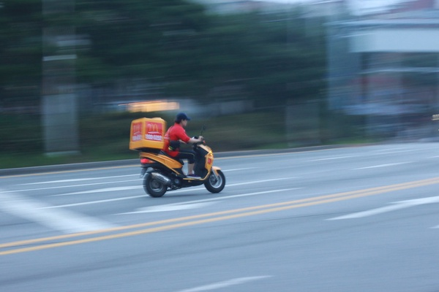
Problem is mainly lack of opportunity
Corsair Study
Predictors: Low income job & financial hardship
Reasons:
caring responsibilities outside of the home
needing provisions
Insecure work/income/employment
Smith, Potts, Fear, Michie, Rubin (2021) Adherence to the test, trace and isolate system: results from a series of 37 nationally representative surveys in the UK (the COVID-19 Rapid Survey of Adherence to Interventions and Responses [CORSAIR] study) BMJ;372:n608

Slide 20
SAGE (SPI-B) provides advice to UK Government
Statutory Sick Pay is £96/week i.e. 16% pay in UK,
Average across 37 OECD countries 70%;many in North and Central Europe paying 100%

Slide 21
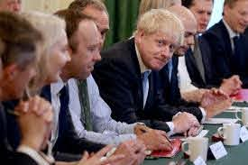
UK Government responded as if problem of motivation
If on low income, £500 (< minimum wage)
Only 1/8 eligible and only 30% receive it
If don’t adhere up to £10,000 fine
Unintended consequences?
Concern that fewer people get tested, give contacts, download app, esp. disadvantaged groups
<30% with symptoms say they got tested
Evaluation of mass testing in Liverpool: only 8% in disadvantaged communities got testing
Corsair Study

Slide 22
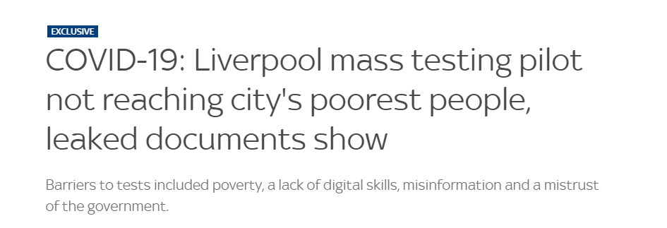

Slide 23
Example of behavioural science advice ignored
Test, Trace and Isolate
advice not implemented
‘Behavioural fatigue’
behavioural science misused/blamed

Slide 24
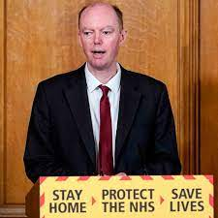
Example: ‘Behavioural fatigue’ … 9 March 2020
Professor Chris Whitty, the UK Chief Medical Officer, argued that it was too soon to implement a lockdown
“There is a risk that if we go too early, people will understandably get fatigued and it will be difficult to sustain this over time”
https://www.youtube.com/watch?v=Yc1alOEjDVA

Slide 25
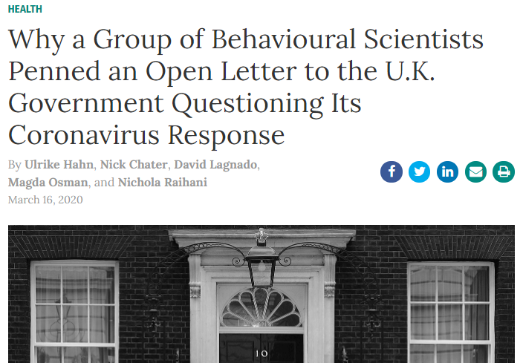
Open letter signed by c600 behavioural scientists, March 2020
“If ‘behavioural fatigue’ truly represents a key factor in the government’s decision to delay high-visibility interventions, we urge the government to share an adequate evidence base in support of that decision. If one is lacking, we urge the government to reconsider these decisions.”
https://behavioralscientist.org/why-a-group-of-behavioural-scientists-penned-an-open-letter-to-the-uk-government-questioning-its-coronavirus-response-covid-19-social-distancing/

Slide 26
Behavioural ‘narrative’ ≠ Behavioural science
Not a behavioural science term
No measure, inclusion in theory, evidence
Never mentioned by UK behavioural science advisory group in discussions or reports

Slide 27
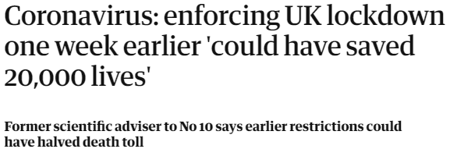
The science of behaviour matters …
Prof Neil Ferguson, UK SAGE modelling group

Slide 28
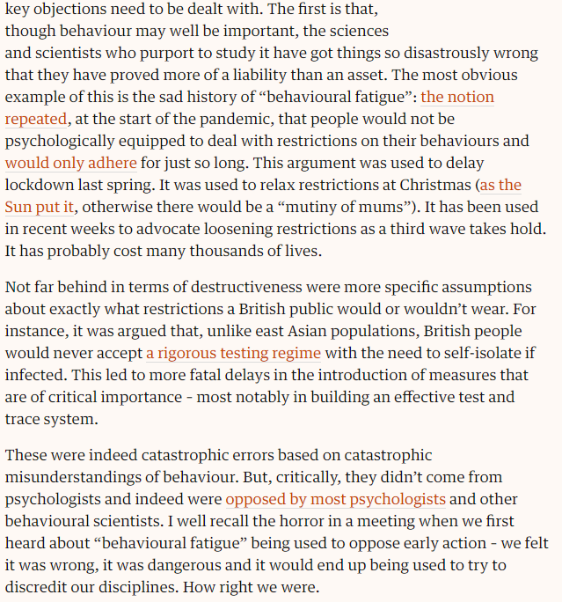
24 June 2021

Slide 29
The term gets global traction e.g.
When people refer to ‘fatigue’, they mean waning motivation to adhere to protective restrictions NOT ‘fatigue’ (= tiredness)

Slide 30
Main messages
There is a science of behaviour and ignoring it matters, e.g.
Test, Trace & Isolate
‘Behavioural fatigue’
Current policies
UK’s science-policy advisory mechanisms should be re-evaluated

Slide 31
Sustaining changed behaviours long-term
https://www.gov.uk/government/publications/spi-b-sustaining-behaviours-to-reduce-sars-cov-2-transmission-30-april-2021/spi-b-sustaining-behaviours-to-reduce-sars-cov-2-transmission-22-april-2021

Slide 32
The future: SPI-B advice
Build, co-ordinate and use behavioural science expertise as we move to a long-term risk management approach of the kind used for e.g. road safety
Invest in achieving a better understanding of key behaviours across contexts and their influences
Apply this understanding across society – risk-reducing behaviours are the responsibility of all including politicians, health professionals, scientists & citizens

Slide 33
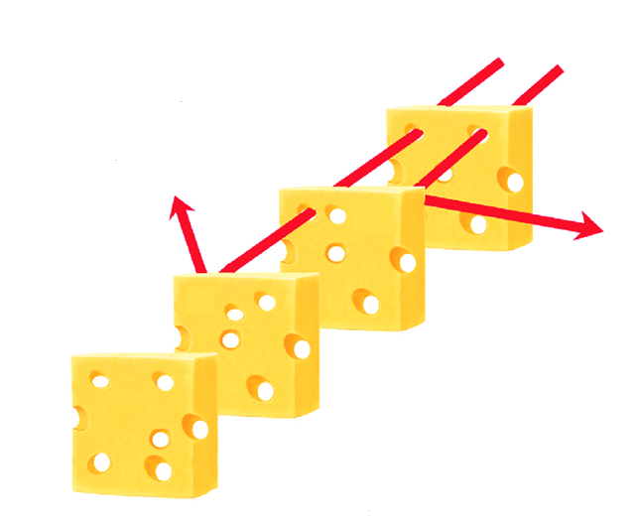
Multi-layered approach to stopping transmission
The Swiss Cheese model
Infection
https://www.bmj.com/content/376/bmj.o1
“Holes” due to failure in testing, tracing, distancing, etc
Systems interventions e.g. Test, Trace & Isolate
Social interventions e.g. building social norms about behaviour
Environmental interventions e.g. improving ventilation
Behavioural interventions e.g to promote vaccination & mask-wearing

Slide 34
World Federation of Public Health Associations, signing in an institutional capacity; Nisreen Alwan, University of Southampton, UK; Raymond Agius, University of Manchester, UK; Haitham Ahmed, AdvantageCare Physicians, New York, USA; Simon Ashworth, Imperial College Healthcare NHS Trust, UK; Charlotte Augst, National Voices, UK; Simon L. Bacon, Department of Health, Kinesiology, and Applied Physiology (HKAP), Concordia University; Emil J. Bergholtz, Department of Physics, Stockholm University, Sweden; David Blanchflower, Dartmouth College and University of Glasgow, UK; Arnold Bosman - Director Transmissible BV; Nissaf Bouafif ép Ben Alaya, National Observatory of New and Emerging Diseases, Ministry of Health; Head of Department of Preventive Medicine, Faculty of Medicine of Tunis, University Tunis El Manar, Tunisia; Katherine Brown, Great Ormond Street Hospital and University College London, UK; Matthew Butler, Cambridge University Hospitals, UK; Molly Byrne, Health Behaviour Change Research Group, School of Psychology, National University of Ireland, Galway, Ireland; Roberto Cacciola, Department of Surgical Sciences, University of Tor Vergata, Rome, Italy; Danielle J. Cane, London School of Hygiene and Tropical Medicine, London, UK; Fidelia Cascini, Dipartimento di Scienze della vita e sanità pubblica, Catholic University of the Sacred Heart, Rome, Italy; Mohamed Chahed, Faculty of Medicine of Tunis, University Tunis El Manar, Tunisia; KK Cheng, Institute of Applied Health Research, University of Birmingham, UK; Anthony Costello, Institute of Global Health, University College London, UK; Andrew Conway Morris, University of Cambridge and European Society of Intensive Care Medicine, UK; Roz Davies, Managing Director, Thrive by Design, UK; Colin Davis, School of Psychological Science, University of Bristol, UK; Brendan Delaney, Imperial College, London, UK; Denise Dewald, Case Western Reserve University School of Medicine, Cleveland, Ohio, USA; David Drew, retired NHS Consultant Paediatrician, UK; John Drury, School of Psychology, University of Sussex, UK; Andrew Ewing, department of Chemistry and Molecular Biology, University of Gothenburg; Swedish Academy of Sciences, Sweden; David Fisman, Professor of Epidemiology, Dalla Lana School of Public Health, University of Toronto, Toronto, ON, Canada; Sharon Friel, Australian National University, Australia; Malgorzata Gasperowicz, Faculty of Nursing, University of Calgary, Canada; David Robert Grimes, Dublin City University and University of Oxford, Ireland; Zubaida Haque, Independent SAGE, UK; William A Haseltine, ACCESS Health International, USA; Orla Hegarty, School of Architecture, Planning and Environmental Policy, University College Dublin, Ireland; Simon Hodes, Bridgewater Surgeries and Cleveland Clinic London, UK; Eilir Hughes, West Wales, UK; Zoë Hyde, Western Australian Centre for Health and Ageing, The University of Western Australia, Australia; Lisa Iannattone, University of Montreal, Canada; Alejandro R. Jadad, Centre for Global eHealth Innovation, Toronto, Canada; Neena Jha, Hertfordshire, UK; Jose Luis Jimenez, Department of Chemistry and Cooperative Institute for Research in the Environmental Sciences, University of Colorado, Boulder, CO, USA; John Johnson, Eastern Health, Melbourne, Australia; Abraar Karan, Division of Infectious Diseases and Geographic Medicine, Stanford University, USA; Kamlesh Khunti, University of Leicester, UK; Najwa Khuri-Bulos, University of Jordan; Adjunct Professor, Paediatric Infectious Disease, Vanderbilt University, Nashville, USA; Woo Joo Kim, Division of Infectious Diseases, Guro Hospital; Director, Chung Mong-koo Vaccine Innovation Center, College of Medicine, Korea University, Seoul, Republic of Korea; Matthew J Knight, West Hertfordshire Hospitals NHS Trust, UK; Kim L. Lavoie, Department of Psychology, University of Quebec at Montreal; Tom Lawton, Bradford Institute for Health Research; Bradford Teaching Hospitals NHS Foundation Trust, UK; Jeffrey V Lazarus, Barcelona Institute for Global Health (ISGlobal), Hospital Clínic, University of Barcelona, Spain; Anthony Joseph Leonardi, Johns Hopkins University Bloomberg School of Public Health, USA; Eyal Leshem, Tel Aviv University School of Medicine, Israel; Liz Lightstone, Imperial College Healthcare NHS Trust, London, UK; Peter V. Markov, London School of Hygiene and Tropical Medicine, London, UK; Jose M Martin-Moreno - Department of Preventive Medicine and Public Health and INCLIVA, University of Valencia, Spain; Petra Meier, University of Glasgow, UK; Jonathan Mesiano-Crookston, Partner Goldman Hine LLP, Canada; Asit Kumar Mishra, NUI Galway, Ireland; Michael Moore, The George Institute for Global Health; Sterghios A. Moschos, Cellular and Molecular Sciences, Northumbria University, UK; C David Naylor, University of Toronto, Toronto, Canada; Taylor Nichols, Sacramento, USA; David Nicholl, Sandwell and West Birmingham NHS Trust, UK; Ole F. Norheim, Department of Global Public Health and Primary Care, University of Bergen, Norway; Matthew Oliver, Association of Professional Engineers and Geoscientists of Alberta, Edmonton, Alberta, Canada; Christine Peters, QEUH NHS Greater Glasgow and Clyde, UK; Deenan Pillay, University College London, UK; Dominic Pimenta, Richmond Research Institute, UK; Kashif Pirzada, McMaster University, Canada; Catherine Pope - Professor of Medical Sociology, University of Oxford, UK; Kimberly A Prather, University of California, San Diego, La Jolla, CA, USA; Geraint Preest, Pencoed, Wales, UK; Zeshan Quereshi, University of Cambridge, UK; Katrin Rabiei, Institution of Neuroscience and Physiology, Sahlgrenska Academy at Gothenburg University, Sweden; James Ray, NHS England, UK; K. Srinath Reddy, Public Health Foundation of India, India; Walter Ricciardi, Università Cattolica del Sacro Cuore Roma, Italy; Ken Rice, School of Physics and Astronomy, University of Edinburgh, UK; Eleanor Robertson, NHS Greater Glasgow and Clyde, UK; Kim Roberts, Department of Microbiology, Trinity College Dublin, Ireland; Tomás Ryan, Trinity College Dublin, Ireland; Helen Salisbury, Nuffield Dept of Primary Care Health Sciences, University of Oxford, UK; Gabriel Scally, Population Sciences, University of Bristol, UK; Robert T. Schooley, University of California San Diego, USA; Vipul Shah, R P Shah Memorial Trust, Lucknow, India; Joshua Silver, Department of Physics, University of Oxford, UK; Natalie Silvey, Imperial School of Anaesthesia, London, UK; Manoj Sivan, University of Leeds and Leeds Teaching Hospitals NHS Trust, UK; Luis Eugenio Souza, Federal University of Bahia; World Federation of Public Health Associations, Brazil; Anthony Staines, School of Nursing, Psychotherapy and Community Health, Dublin City University, Ireland; David Tomlinson, University Hospitals Plymouth NHS Trust and Fresh Air NHS, UK; Collin Tukuitonga, Faculty of Medical and Health Sciences, University of Auckland, New Zealand; Charles Vincent, University of Oxford, Oxford, UK; Joe Vipond, University of Calgary, Canada; Robert West, Institute of Epidemiology and Healthcare, University College London, UK; Angela C. Weyand, University of Michigan Medical School, Ann Arbor, MI, USA; Hisham Ziauddeen, Department of Psychiatry, University of Cambridge, Cambridge.

Slide 35
An effective pandemic management strategy requires …
Good leadership that engenders trust
Good communication so people know what to do, when and why
Countering misinformation and disinformation
Effective community engagement
Each of these have a large empirical and theoretical bodies of knowledge in psychology

Slide 36
Main messages
There is a science of behaviour and ignoring it matters, e.g.
Test, Trace & Isolate
‘Behavioural fatigue’
Current policies
UK’s science-policy advisory mechanisms should be re-evaluated

Slide 37
What is the responsibility of scientists?
If the science was not followed, “scientists have a right and an obligation to ask why not …
they should not passively resign themselves to the ‘on tap’ status assigned to them by Winston Churchill”

Slide 38
Some questions about the science-policy interface
Scientists talk about science; politicians talk about policy?
What level of confidence is appropriate when giving scientific advice to policymakers?
What is our role in bringing about change?

Slide 39
What should the science/policy relationship be?
On the one hand …
Scientists
are not elected officials
often unfamiliar with the policy context
On the other hand …
Evidence doesn’t implement itself
Policymakers often don’t understand the scientific advice nor how best to translate it
Translation & implementation are themselves the subject of scientific enquiry
Shouldn’t social scientists be asked to advise on the translation process itself?
Shouldn’t scientists work in partnership with policymakers along the translational pathway?

Slide 40
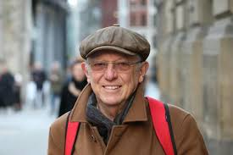
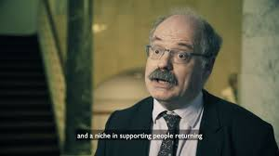
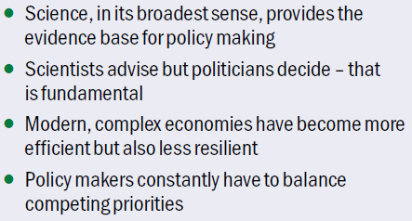
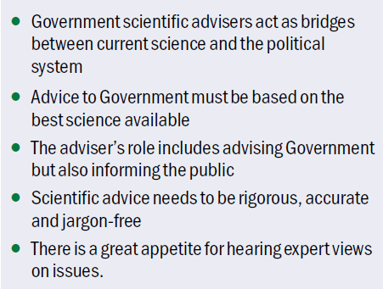
Two views from ex- Govt Chief Scientific Advisors
Sir David King
Sir Mark Walport

Slide 41
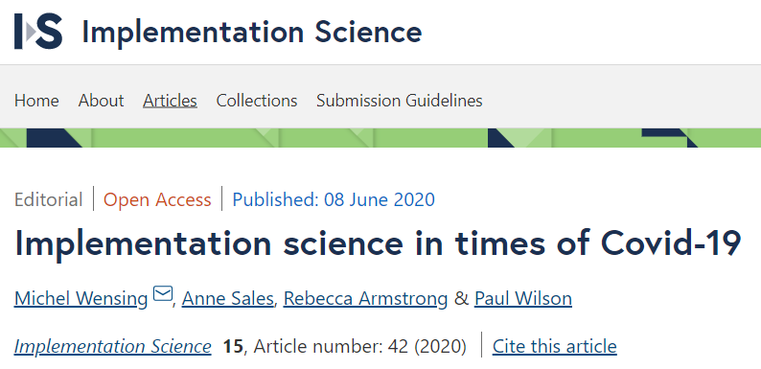
The Science-Policy interface
Mantra amongst some of the scientific community of “Scientists advise, politicians decide”
Helps to protect scientists, but in many think it is an artificial divide
There is a translational pathway from scientific advice to policy & practice
There is a science of implementation
“it is never sufficient to produce and disseminate information for changing behaviour, organizations and systems”

Slide 42
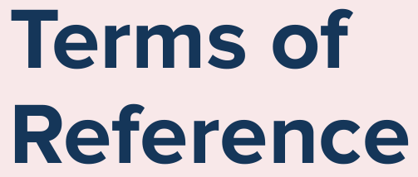
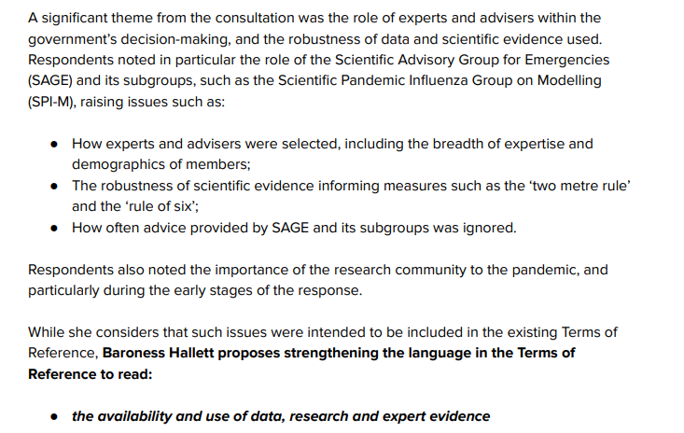
On the role of advisors …

Slide 43
Conclusions about scientists’ advisory role
There should be no ‘hard border’ between scientists and policy-makers
Instead there should be engagement at all stages of the translational pathway
The process of translation is itself a subject of enquiry for social scientists, including psychologists and behavioural scientists
Scientists have a responsibility to not only engage with advising Government but with society more broadly, including the public

Slide 44
Aim: put scientific evidence and debate into the public domain, on basis that
openness and transparency leads to better understanding and better decision-making
it is the responsibility of scientists and those with specialist knowledge to engage with the public and policy makers, in order to ensure that science benefits all of society
Every Friday 1.30pm, public live-streamed briefings
data-based updates
invited guests
Q&As with the public, politicians & the press
Website: www.independentsage.org
www.independentsage.org
20K subscribers, up to 20K viewers

Slide 45
Acknowledgements
Many colleagues from the UK Government’s behavioural science advisory group to SAGE, and from Independent SAGE
Funders of my COVID-19 research

Slide 46
Discussion
Further details
s.michie@ucl.ac.uk
@susan.michie
www.ucl.ac.uk/behaviour-change/
@UCLBehaveChange

